Slide 1

General SHAC Meeting
Celebrating Farm Fresh Month!
October 18, 2023

Slide 2


Welcome & Mindful Moment
Allison Thummel
Fort Bend ISD SHAC Chair

Slide 3
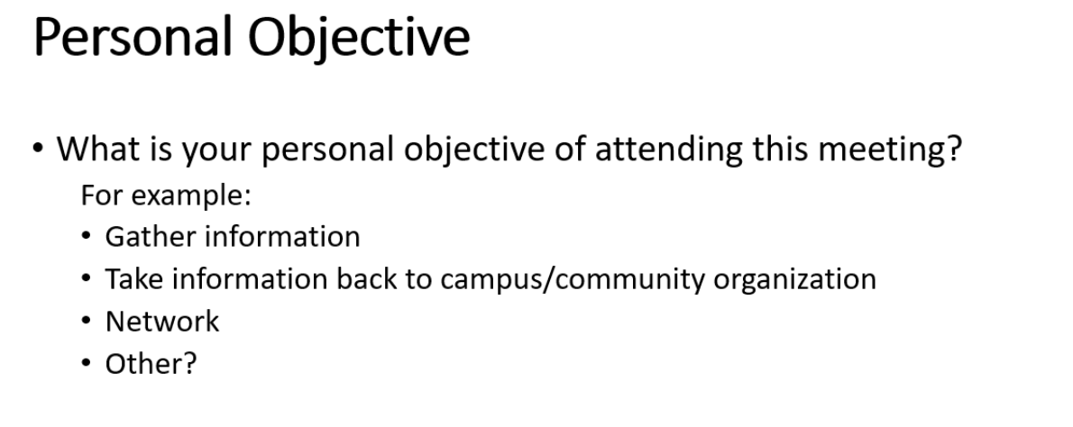
Personal Objective of Meeting
Text

Slide 4
Celebrating Shared Dreams Donation Drive

Slide 5
SHAC Support: 10/18 & 12/6
Shared Dreams provides temporary support to registered students in need who have been designated by school staff. There is a high need for food items:
Canned chicken
Peanut butter (plastic containers)
Jelly (plastic containers)
Breakfast bars or individually wrapped snacks (i.e., pretzels, cheese crackers)
Canned fruit
Donate funds to Shared Dreams so purchases can be made as needs arise: bit.ly/3E6WYU2

Slide 6

Shared Dreams 35th Anniversary: Join Us!
RSVP: https://bit.ly/3RWgzi6

Slide 7
SHAC Executive Team Introductions

Slide 8
SHAC Executive Team
Allison Thummel, Chair
Dana Tran, Co-Vice Chair
Ana Flores-Rau, Co-Vice Chair
Jenna Ross, Secretary
Jigisha Doshi, Membership Coordinator
Melanie Anabarci, Communication

Slide 9
Student Engagement Survey Update
Tiffany Unruh, FBISD Director of Strategic Planning

Slide 10
Background
Student Engagement Survey
2022 – 23
Year 3 Administration Secondary (6 – 12)
Year 2 Administration Elementary (3 – 5)
Notes:
As we look at the student engagement survey results, this year marks the 3rd year of administration for students in grades 6-12, and the 2nd year for students in grades 3-5. This means that we have 3 years of trend data that we can analyze and build upon in improvement planning efforts to increase student engagement.

Slide 11

Overview Student Engagement Survey
Key Findings and Trends
Where are we?
Next Steps
What must we address?
How can we get there?
Notes:
In our presentation tonight, we will provide some background information about the development, administration, and analysis of the survey data, including a brief introduction to student engagement in FBISD. Then we will explore the key findings and trends from the survey results, illustrate how they connect, their implications across the stakeholder groups, as well as the role the results play in improvement planning at the campus and district level.

Slide 12

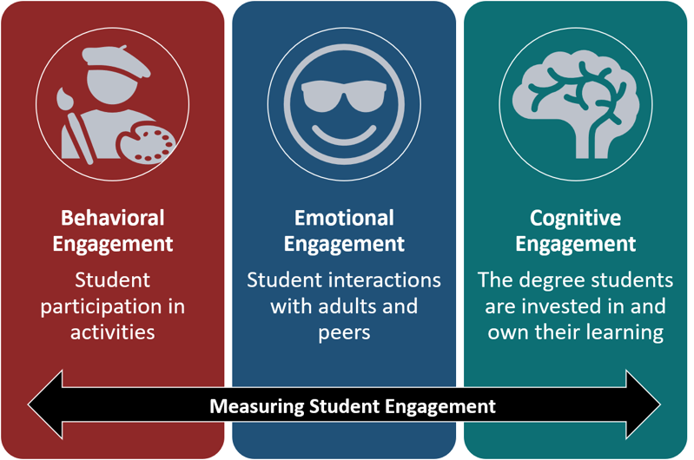
Subhead
Student
Engagement
Survey
Notes:
Student Engagement is defined by 3 dimensions
Behavioral Engagement- looking at how students participate in school activities
Emotional Engagement- exploring the student interactions with adults and peers on campus, and
Cognitive Engagement- focusing on the degree students are investing and own their learning.
In the next few slides, we will briefly describe the overall results for the secondary and elementary administrations of the student engagement survey before transitioning to the triangulation of the survey results with other stakeholder groups.

Slide 13
Secondary Student Participation
Student Group | Secondary FBISD Students | Surveyed Students
African American | 29% | 24%
Asian | 27% | 34%
Hispanic | 26% | 24%
White | 14% | 15%
ED | 50% | 44%
SPED | 12% | 8%
GT | 8% | 11%
EL | 15% | 15%
Total Secondary Students in FBISD
44,790
Secondary Students Participated in Survey
24,319
Percent of Eligible Students Participated
69%
Notes:
This year, we had 24,319 secondary students participate in the student engagement survey. This represented 69% of eligible students. We had approximately 1,000 more secondary students participate this year, although the participating percentage decreased as we had a large increase in the number of students who were eligible to participate this year (up 7,000 students).
The chart you can see here compares the demographics of students who participated in the survey to the district student demographics. At the secondary level student groups had similar representation in the survey results. Students participated in the survey during their advisory periods in the survey window of 3/27 to 4/15.
The survey window was open from March 27th to April 15th
Presenters Notes:
35,157 S eligible in 2023 (compared to 27,200 last year)
More students took the survey (1000 more) than last year, but more students were eligible( 7,000 more students were eligible- (so less %)
there were a few groups who were slightly over represented in the survey (Asian, GT, white), and a few groups who were slightly underrepresented. (AA, H, SPED)
86% was participation rate in 2022.

Slide 14
Student Engagement Dimensions
Secondary
Behavioral Engagement
Emotional Engagement
Cognitive Engagement
Overall mean score 2.78 ↓ 5.8% from 2022
Overall mean score 2.82 ↓ 1.9% from 2022
Overall mean score 2.87 ↓ 1.1% from 2022
Engagement Score Scale
Very Low | 1.0-1.75
Low | 1.76-2.50
Moderate | 2.51-3.25
High | 3.26-4.0
Notes:
The secondary survey is adapted from the Middle/High School Survey of Student Engagement MSSSE/HSSSE, In addition to questions in these scored areas of the survey on the screen, additional questions provide insight into instructional interests, student ownership of learning practices, and perceptions health and wellness were added this year.
Student responses for each question are assigned a value between 1 and 4, for example, strongly agree would be worth 4 points, agree with 3 point, etc. For each question that is assigned to each factor/dimension, the student scores can then be averaged to create a mean score.
We will briefly discuss some areas of strength and areas of concern in each of these areas. Areas of strength are represented by either positive changes we saw in the student responses either in the overall scores, or the value of responses to specific questions in those areas. We will also share areas of concerns identified by staff that could represent a decrease in scores compared to previous years or student responses that are lower than what we believe our district targets should be.
At the secondary level, Here on the screen we can see the mean score for each dimension and factor as well as see the % change in the mean score compared to the 2022 survey results. These scores can be compared to the engagement score scale to differentiate between very low, low, moderate and high levels of engagement. At the secondary levels, all dimensions and factors fell within the moderate levels of engagement category.
We observed decreases across all three dimensions compared to the previous two years. The changes in the mean scores for emotional and cognitive engagement decreased by less than 2% compared to last year which represents a small change in the overall dimension.

Slide 15
Behavioral Engagement – Key Findings
Secondary
Behavioral Engagement
Areas of Strength
Teachers increased as the positive motivation to attend school
Areas of Concern
Decreases in time spent participating school activities
Contribution of schools in learning to treat others with respect
Grades 6-12
Notes:
We observed the largest decrease in behavioral engagement- how students are participating in activities at school. This could be indicative a changes in a post pandemic era, but does signal a need to find ways for students to engage in school activities. The areas of strength and concern in this dimension are based on individual question responses.
More students reported being motivated to attend school because of teachers at the MS level,
There was a large drop in the student responses to how much time they spend each week engaging in school sponsored activities (23.9% drop in the score) meaning that 70% of students spend less than 3 hrs per week engaging in school activities (38% spend less than 1 hour).
Given what we know about the connections between school involvement, achievement and graduation rates, this was an area identified as a concern. Additionally Fewer students felt that their school contributes to them treating people with respect (down 4.6%)
Presenter Notes:
Teacher influence on attendance up in MS (2.5%), down in HS 2.3%
Treating people with respect was still high 80% but decreased by 4.8% compared to LY

Slide 16
Emotional Engagement
Emotional Engagement Factors – Key Findings
Secondary
Areas of Strength
High desire for good grades and success in world outside of school
Areas of Concern
Positive Relationships with School Staff & Other Students
Feelings of Safety, Acceptance
Decreases in Availability of Support from Staff
Application of Rules and Discipline
Overall Emotional Engagement (p.15) | 2.82 ↓1.9%
Motivation for Learning (p. 16-18) | 2.89 ↓1.1%
Emotional Engagement with School (p. 19-21) | 2.66 ↓1.8%
Positive Relationships with Adults in School (p.22-23) | 2.84 ↓2.0%
Positive Relationships with Other Students (p. 24-25) | 2.92 ↓3.4%
Grades 6-12
Notes:
In the emotional engagement dimension, we saw decreases across all factors, with the largest loss in the positive relationships with other students (average score down 3.4%). This factor included questions regarding feelings of acceptance, bullying, feeling safe at school.
Some areas of strength to highlight include progress in areas around student motivation for learning
86% of students describe their motivation for learning as their desire to success in the world outside of school, this value was high, however we did see a drop of 2.8% compared to previous years.
Student responses demonstrated an increase in the percent of students who are excited about their classes (2.1%) but the overall percent of students who agree with that statement remains low (59%)
In this dimension there were several areas of concern that we have highlighted here including positive relationships with staff and students, feelings of safety and acceptance, availability in support from staff, and the application of rules and discipline.
Staff also noted a decrease in student perceptions of support from teachers, administrator, counselors and other adults (ranging from 1.5-3.7%),
¾ of students feel comfortable and supported by students at school, however both of those percents decrease by 2-3.8% compared to last year.
69% of secondary students reported feeling safe at school which was a 6.9% drop from the previous school year.
More students also reported being picked on or bullied compared to previous years and fewer students reported feeling safe at school
Picked on bullied 45% (up 8.1%)
Witness bullying 60% (up 5.6%)
Presenter Notes:
(Factor scores)
Pos Rel with Adults in School- Decrease 2.0% compared to LY
Pos Rel with Other Stud- Decrease 3.4% compared to LY
Question responses
Support from staff decreased between 1.5 and 3.7% compared to LY p.21
Feelings of safety decreased 6.9% compared to LY p. 23
Rules being fair or enforced consistently decreased 2.1-2.6% compared to LY p. 18

Slide 17
Cognitive Engagement Factors – Key Findings
Secondary
Cognitive Engagement
Areas of Strength
Increase in Level of Effort in Academic Pursuits
Areas of Concern
Relevance and Interest in Learning
Increase in Engagement with Academic Goals, Future plans, and Aspirations
Decrease in attitude toward learning
Degree of Academic Challenge
Overall Cognitive Engagement (p. 26) | 2.87 ↓1.1%
Cognitive Growth through Personal Skill Development (p. 27-31) | 2.89 ↓1.9%
Level of Effort in Academic Pursuits (p. 32-36) | 2.92 ↑0.8%
Attitudes Towards Learning (p.37-39) | 2.86 ↓1.2%
Cognitive Engagement with Academic Goals, Future Plans, and Aspirations (p. 40-42) | 2.73 ↑0.5%
Grades 6-12
Notes:
In the Cognitive engagement dimension, we saw increases and decreases in the individual factors and questions in this area. This dimensions scoring has changed the least during the last three years (2.92 in 2021, 2.91 in 2022, and 2.87 in 2023)
Some areas to strength to highlight include where we observed slight positive changes in how much efforts students are putting into their learning, and more students described engaging with staff members around college and career goals.
91% of students felt they had the skills and ability to complete their work.
More students reported that they have talked to adult about college or career goals (up 2.8 and 4.6% compared to last year)
fewer students reported Never talking to an adults about CC goals (down 2.1 and 5.4% which is a double negative)
In this dimension there were some areas of improvement that were identified around relevance and interest in learning, students attitudes toward learning, and the level of challenge that students felt their classes offered.
57% of secondary students said they go to school because of what they learn in classes), 81% enjoy being creative in school, but this dropped 3.2% compared to last year)
fewer students reported feeling that they give their maximum effort in class (down 1%) more students reporting putting very little effort in their classes-up 3.8%)
Presenter notes:
Perceptions of academic challenge- we saw gains here (up 3.7% compared to LY) however less than 50% of students feel their classes challenge them to their full potential )
From pg 51 of report 92% of students report feeling bored in class, 49% say often, because the material wasn’t interesting, teacher methods weren’t interesting, (top 2 reasons)
Pg52, 18% of students considered dropping out with 9% sometimes or often. Reasons include 59% they didn’t like the school, 48% didn’t see the value in the work

Slide 18
Elementary Student Participation
Student Group | Elementary FBISD Students | Surveyed Students
African American | 26% | 23%
Asian | 28% | 32%
Hispanic | 26% | 24%
White | 14% | 16%
ED | 50% | 44%
SPED | 17% | 13%
GT | 8% | 10%
EL | 26% | 25%
Total Elementary Students Grades 3 – 5 in FBISD
16,941
Elementary Grades
3 – 5 Students Participated
11,207
Percent of All Eligible Grades 3 – 5 Students Participated
88%
Notes:
For elementary students, this was the second year of administration for grades 3-5. There were 11,207 or 88% of eligible students who participated this year compared to 12,195 students participating last year. This year there were fewer students who were eligible to complete the survey. The chart on this screen shows the demographics of elementary students in the district versus those who participated in the survey. We saw similar trends in student participation as in the secondary survey results (over in A, W, GT and under in AA, H,ED,SPED).
Elementary students took the survey during their homeroom periods during the survey window where teachers read each question aloud to ensure that reading level was not a barrier for student participation.
Presenter notes:
12712 S eligible this year to take the survey (which is why we had a higher percent of participation (88%) compared to last year (85%).

Slide 19
Overall Dimensions
Elementary
Behavioral Engagement
Emotional Engagement
Cognitive Engagement
Overall mean score 2.41 ↓ 0.3% from 2022
Overall mean score 3.29 ↓ 0.3% from 2022
Overall mean score 3.58 ↑ 5.3% from 2022
Engagement Score Scale
Very Low | 1.0-1.75
Low | 1.76-2.50
Moderate | 2.51-3.25
High | 3.26-4.0
Notes:
The Student Engagement Instrument for the Elementary Students (SEI-E), uses scoring categories in the emotional and cognitive engagement areas. There are not validated questions from that survey on behavioral engagement. Staff included some of the behavioral engagement questions carried over from the secondary survey to provide anecdotal comparisons.
You can see from the results that all the overall mean scores for emotional and cognitive engagement are in the high level of engagement on the engagement score scale. As we review these results it will be important to keep this in mind. Elementary students generally responded more positively across all areas. As we strive for continuous improvement we have still identified areas of concerns to help support continuous improvement efforts.

Slide 20
Behavioral Engagement – Key Findings
Elementary
Behavioral Engagement
Areas of Strength
Students Prepared for Learning
Areas of Concern
Level of participation in clubs or school activities
Grades 3-5
Notes:
Remember that Behavioral engagement focused on participation in school activities, and interactions with the school community.
An area of strength to highlight in this area is on the degree that students feel prepared for learning. Over 77% of elementary students in grade 3-5 feel that they are prepared with what they need to do their work (77%), reading materials (82%), and completed homework (78%)
As area of concern or improvement related to the level of participation in clubs or school activities
74% of students in grades 3-5 reported spending less than an hour a week participating in school sponsored activities or clubs, this could indicate a need to improve communication or availability of clubs and activities available for students.

Slide 21
Emotional Engagement
Emotional Engagement Factors – Key Findings
Elementary
Areas of Strength
Increases in Family, Peer, Teacher Support of Learning
Areas of Concern
Positive Relationships with School Staff & Other Students
Feelings of Safety
Perceptions of Fairness
Perceptions of Respect and Personal Student Support
Overall Emotional Engagement (p. 14-25) | 3.29 | ↓0.3%
Teacher-Student Relationships (p.15 - 18) | 3.25 | ↓1.4%
Peer Support for Learning (p. 19-21) | 3.17 | ↑1.1%
Family Support for Learning (p. 22-23) | 3.58 | ↑0.2%
Disaffection (p. 24-25) | 3.06 | ↓0.1%
Grades 3-5
Notes:
Emotional engagement at the elementary level remained at the high engagement level (3.29 overall score) and was similar to the results from last year, with less than a 1 % change in the score.
We saw high levels of support that students described from teachers, peers, and family members
92% of teachers are there for me when I need them
96% of students reported having friends at school
92% I enjoy talking to the student here
97% of students say their family is there for them when they need them
Areas that we saw as concerns were area of less agreement from students (under 85%) or where there were decreases compared to previous years. These areas involved developing positive relationships, feelings of safety and fairness, and perceptions of respect and support.
Positive relationships with staff/students
84% adults at school listen to the students
83% other students care about me
Safety
83% of students grades 3-5 reported feeling safe at school (decrease of 3.1% compared to LY)
Fairness
84%- adults at school are fair towards students most of the time (decrease of 1.1%)
80% of students feel the rules at school are fair (down 1.5%)
Perceptions of respect and personal student support
81% student are there for me when I need them
70% students respect what I have to say
80% other students like me the way I am

Slide 22
Cognitive Engagement Factors – Key Findings
Elementary
Cognitive Engagement
Areas of Strength
Student Motivation for Learning
Connection to College, Career, and Future Goals
Overall Cognitive Engagement (p. 26-31) | 3.58 | ↑0.3%
Future Goals and Aspirations (p. 27-29) | 3.62 | ↓0.5%
Intrinsic Motivation (p. 30-31) | 3.50 | ↓0.2%
Grades 3-5
Notes:
All the areas in cognitive engagement for grade 3-5 elementary students were very high in survey results. Questions in this area focuses on student motivations and looking toward future goals. All student responses were above 90%
96% of students believe that continuing to learn after high school is important.
95% plan to go to college
90% of students demonstrated intrinsic motivation for learning, not needing a reward for them to learn.

Slide 23
District Next Steps
Identified Focus Areas
Improve Safety & Address Behavior Consistently
Improve Student Emotional Engagement (relationships, participation, etc.)
Build Student Understanding of/Access to Supports
Improve Student Cognitive Engagement –Learner Experience
Survey Results
District Summary
Reflection and Analysis
District Leaders & Staff
Improvement and Action Planning
Development of District and Campus Improvement Plan Performance Objectives
Strategy Development
Individual Campus Results
Campus Leaders & Staff
Notes:
District and Campus leaders have reviewed both the District summary as well as individual campus data for the student engagement and culture and climate reports. After detailed review and analysis there were four identified focus areas that align to our district priorities.
Those identified focus areas include:
Improving perceptions of safety and addressing behavior more consistently
Improving student emotional engagement with school through building positive relationships, increasing participation at school
Ensuring that students are aware of and understand how to use the various support available in the district
Improve student cognitive engagement through effective design of engaging learning experiences.
These areas of improvement are being used in the development of campus and district strategies to focus our work on continuous improvement in FBISD.

Slide 24
Subhead
?
Questions

Slide 25
Harvest Green: Agmenity
Bethany Busa

Slide 26
SHAC Supporting Farm Fresh Month
Nicole Juracek, Neil PTO Vice President

Slide 27
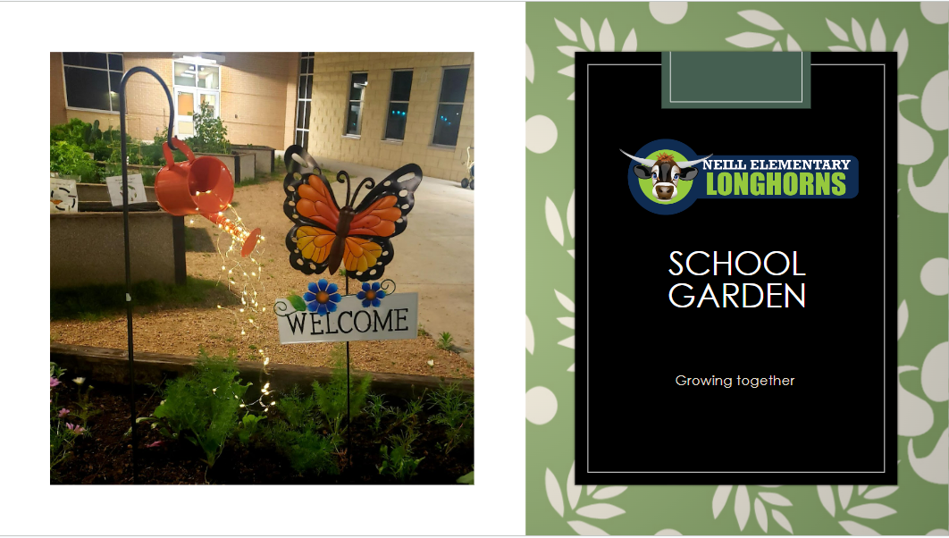

Slide 28
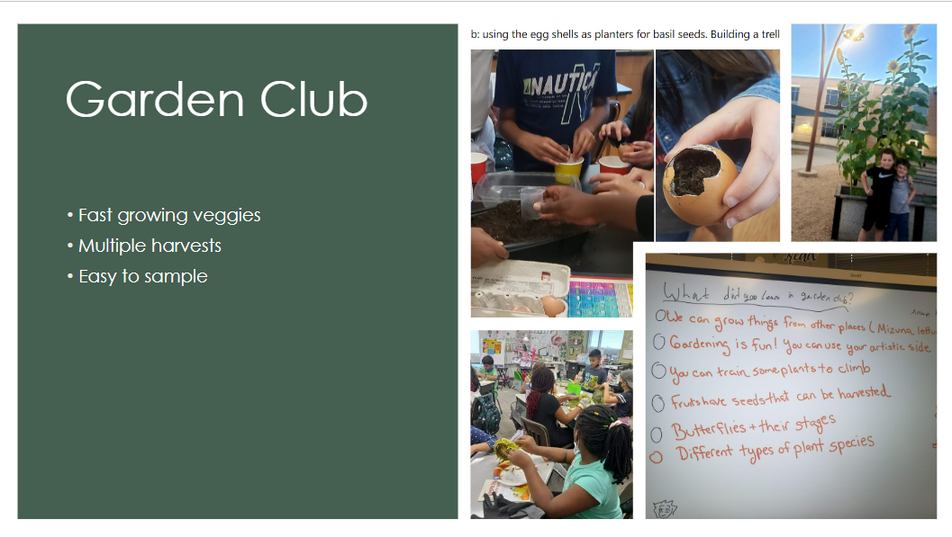

Slide 29
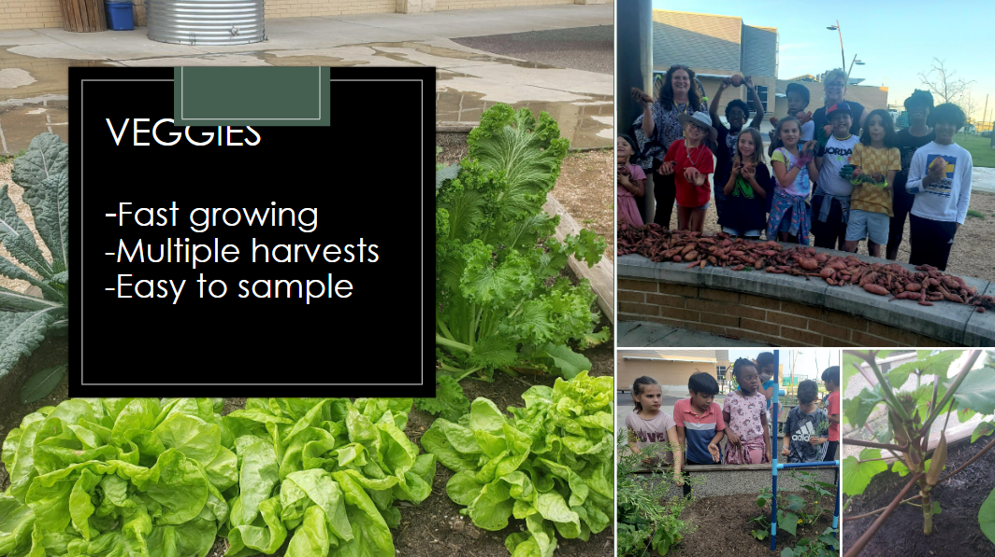

Slide 30
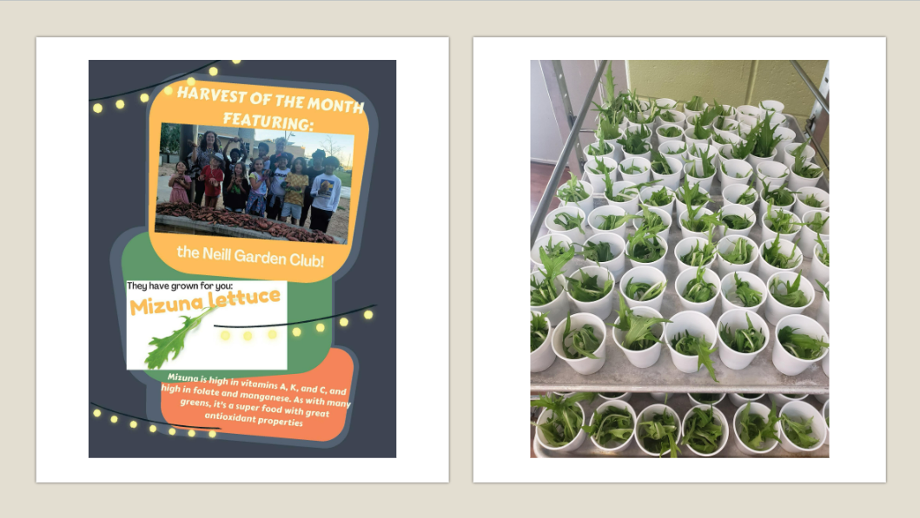

Slide 31
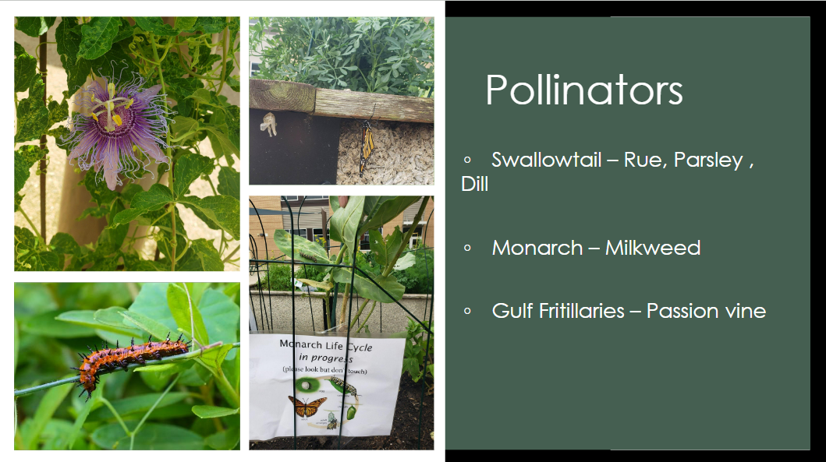

Slide 32
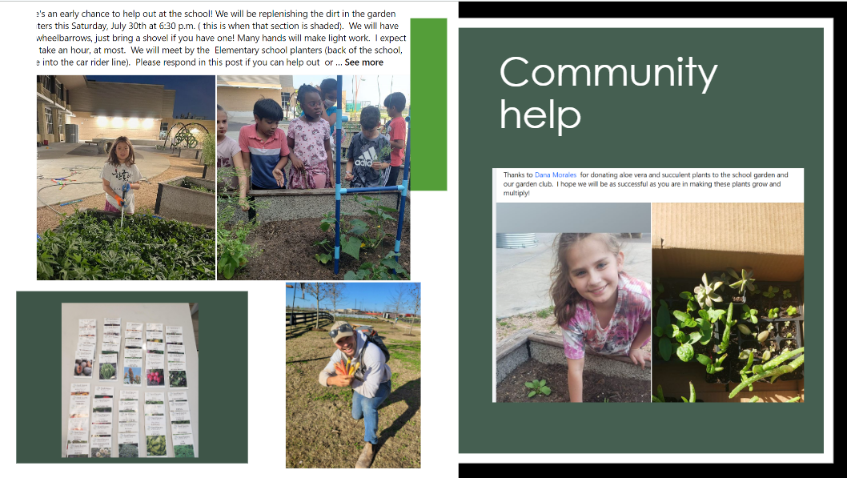

Slide 33

Vote
General SHAC
Meeting Minutes
September 6, 2023
Jenna Ross
SHAC Secretary

Slide 34
Upcoming Events
LaDonna Green, FBISD Wellness Health & Prevention Specialist

Slide 35

October 18th: Unity Day
WEDNESDAY, OCTOBER 18, 2023
WEAR AND SHARE ORANGE
To unite for kindness, acceptance, and inclusion to send a visible message that no child should ever experience bullying.

Slide 36
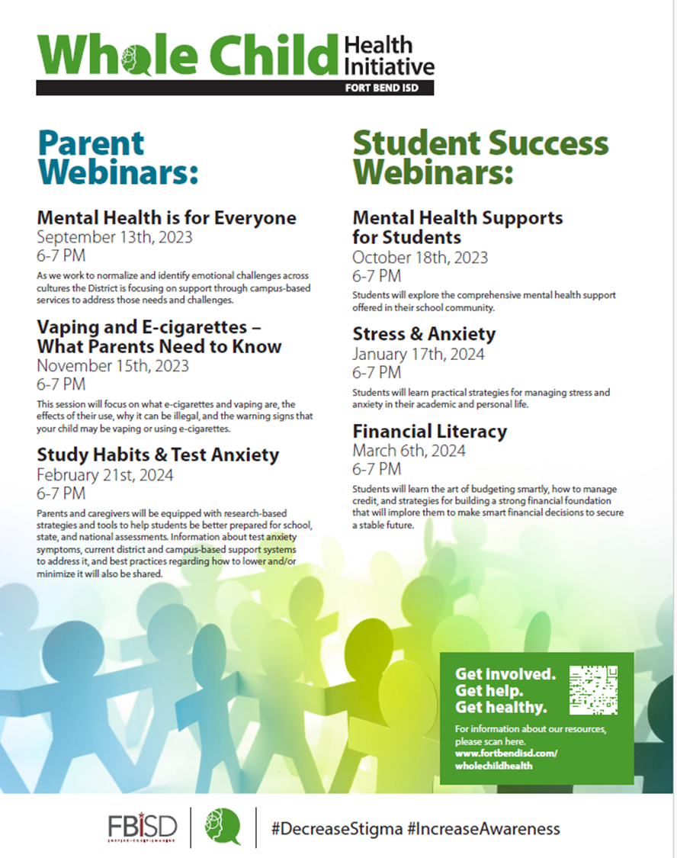
Upcoming Webinars
Subhead
Student Success Webinar
Mental Health Supports for Students
October 18, 2023
6-7 PM
Parent Webinar
Vaping and E-cigarettes- What Parents Need to Know
November 15, 2023
6-7 PM
Whole Child Health Webinar Page

Slide 37


Subhead
29th Annual Food Fair & Tasting

Slide 38
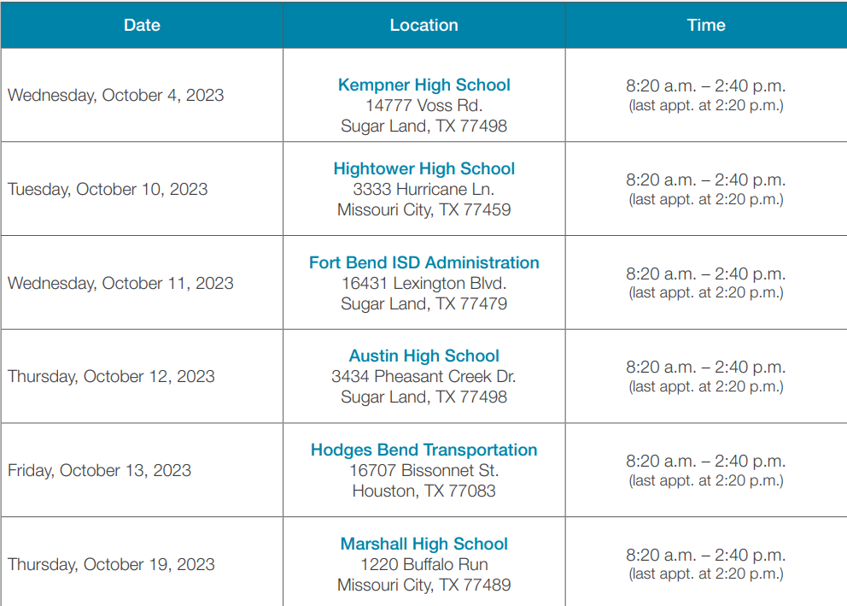



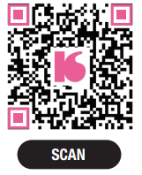
Mobile Mammography

Slide 39



Upcoming Event
Health & Wellness Fair
Date: October 21, 2023
Time: 9 AM – 11 AM
Location
James Reese Career & Technical Center
12300 University Blvd
Sugar Land, TX 77479

Slide 40

Upcoming Event
MCMS 2023 Fall Run/Walk & Fall Festival
Date: October 28, 2023
Time: 9 AM – 12 PM
Location
Missouri City Middle School
202 Martin Ln
Missouri City, TX 77489

Slide 41

Upcoming Event
TX AFHK Fall Summit
Virtual Conference
Date: October 24-25, 2023
Time: 11:30 AM-4:30 PM (Oct 24)
8:30 AM – 12 PM (Oct25)

Slide 42
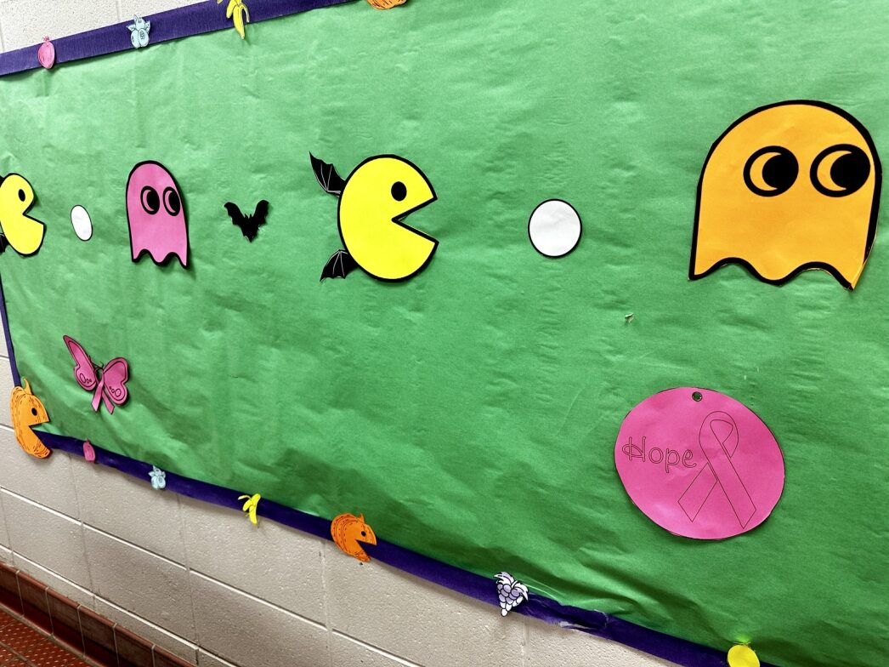
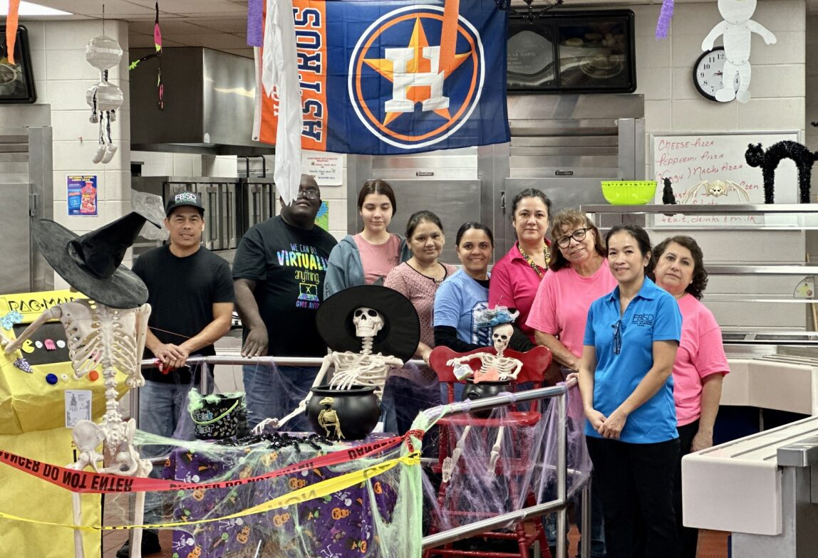
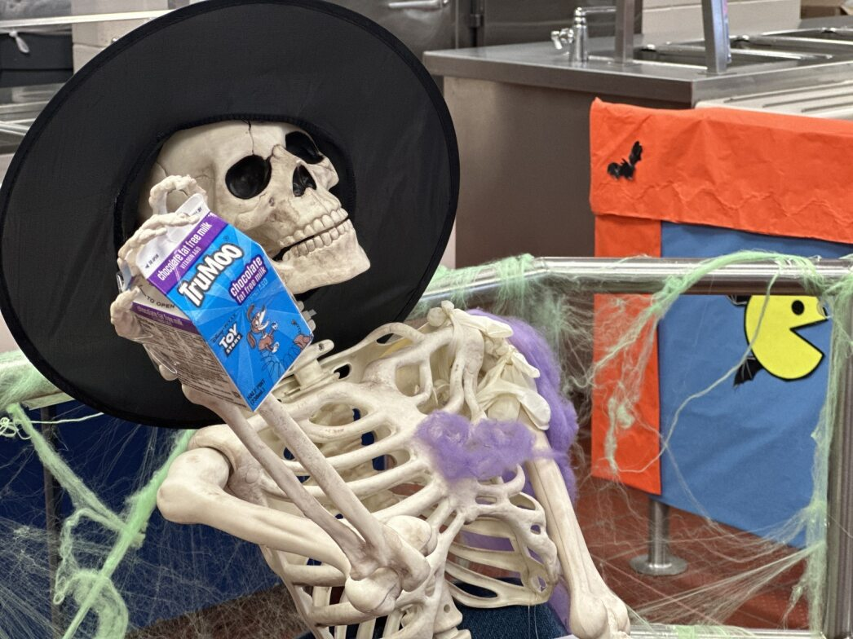
National School Lunch Week- Garcia MS
Text

Slide 43
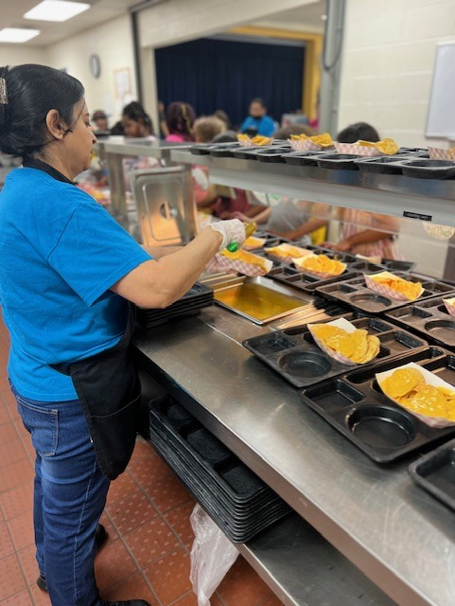

National School Lunch Week- Oakland ES
Text

Slide 44

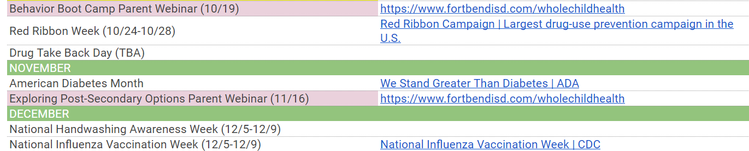
Liaison Action Items
Follow-up with your Campus Wellness Committee (CWC)
Spread the word about student survey information
Use survey information to make a difference @ your campus
Think about starting or supporting school garden
Attend a CWC-sponsored event
6) Promote upcoming health initiatives:

Slide 45

Next General SHAC Meeting
December 6, 2023
12 PM – 2 PM
Location
FBISD Administration Building
16431 Lexington Blvd
Sugar Land, TX 77479

Slide 46

Subcommittees Convene
Subcommittees Convene
Whole Child Health, Nutrition, Advocacy, Health & Safety, Health & PE

Slide 47

FORT BEND ISD
16431 Lexington Blvd.
Sugar Land, TX 77479
281-634-1000
www.fortbendisd.com

